Slide 1
SPAM EMAIL CLASSIFIER
BY-POOJA MANDAOKAR

Slide 2
Overview of Presentation
Project Context
Content/Problem Statement.
Data Preprocessing
Exploratory data analysis.
Feature Engineering
Machine Learning Building.
Limitations and Future Scope of work

Slide 3
Context
The SMS Spam Collection is a set of SMS tagged messages that have been collected for SMS Spam research. It contains one set of SMS messages in English of 5,574 messages, tagged according being ham (legitimate) or spam.

Slide 4
CONTENT/problem statement
Spam Detector is used to detect unwanted, malicious and virus infected texts and helps to separate them from the nonspam texts. It uses a binary type of classification containing the labels such as ‘ham’ (nonspam) and spam. Application of this can be seen in Google Mail (GMAIL) where it segregates the spam emails in order to prevent them from getting into the user’s inbox.
The files contain one message per line. Each line is composed by two columns: v1 contains the label (ham or spam) and v2 contains the raw text.

Slide 5
CONTENT
This corpus has been collected from free or free for research sources at the Internet:
-> A collection of 5573 rows SMS spam messages was manually extracted from the Grumbletext Web site. This is a UK forum in which cell phone users make public claims about SMS spam messages, most of them without reporting the very spam message received. The identification of the text of spam messages in the claims is a very hard and time-consuming task, and it involved carefully scanning hundreds of web pages.
-> A subset of 3,375 SMS randomly chosen ham messages of the NUS SMS Corpus (NSC), which is a dataset of about 10,000 legitimate messages collected for research at the Department of Computer Science at the National University of Singapore. The messages largely originate from Singaporeans and mostly from students attending the University. These messages were collected from volunteers who were made aware that their contributions were going to be made publicly available.

Slide 6
Data Preprocessing
The data set contains 5572 Rows and 2 Columns
There are no null values in the data set.
Duplicate values are removed from the dataset.
Feature Extraction is done by importing NLKT Library and also Stopwords is imported.
Number of characters,Number of Words and Number of sentences are included as columns.

Slide 7
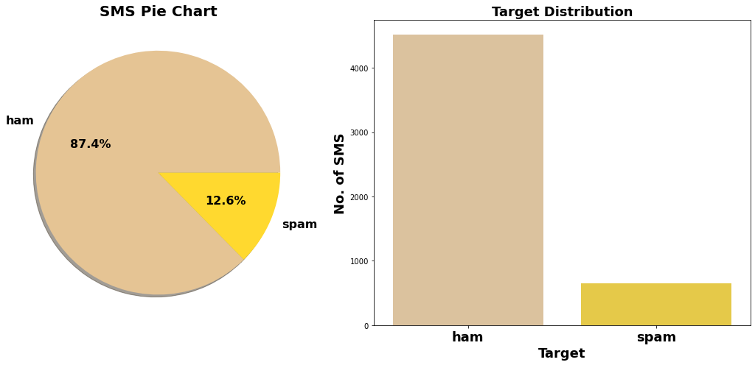
EDA-Exploratory data analysis

Slide 8
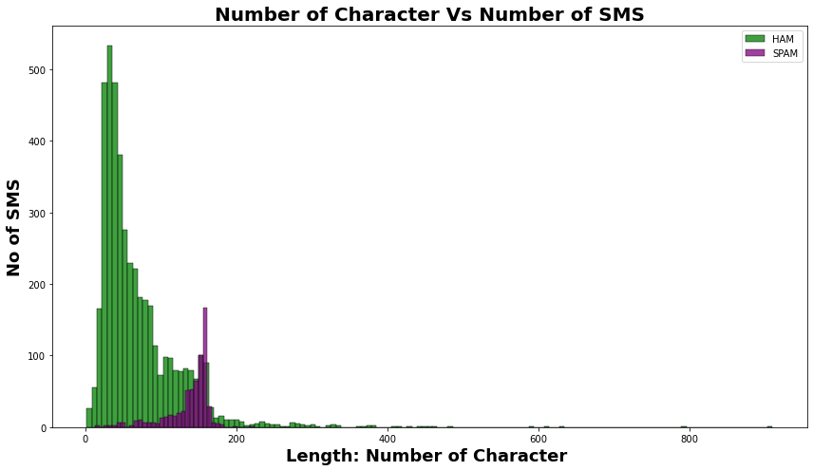
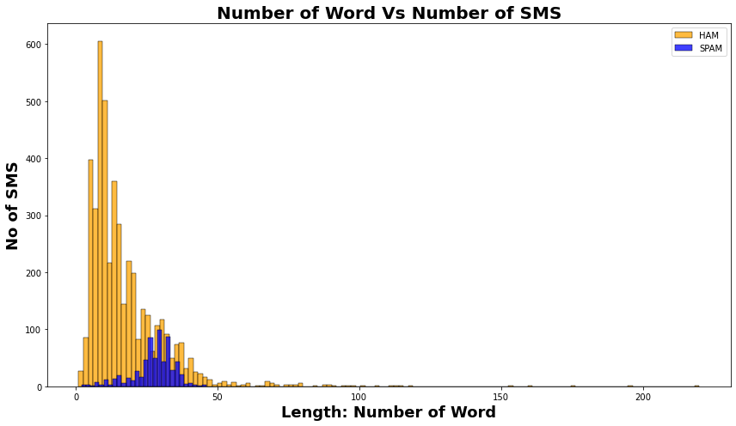
EDA

Slide 9
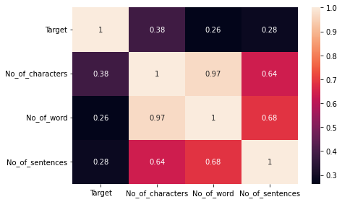
EDA Heatmap

Slide 10
Word Cloud
Word Cloud Defination:
Word Cloud is a visualization technique for text data wherein each word is picturized with its importance in the context or its frequency. The more commonly the term appears within the text being analysed, the larger the word appears in the image generated. The enlarged texts are the most number of words used there and small texts are the less number of words used.

Slide 11
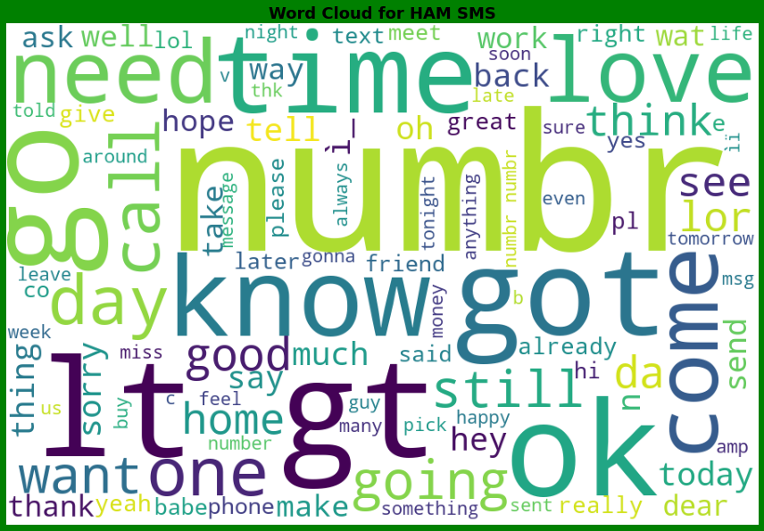
Word Cloud Word Cloud for HAM SMS

Slide 12
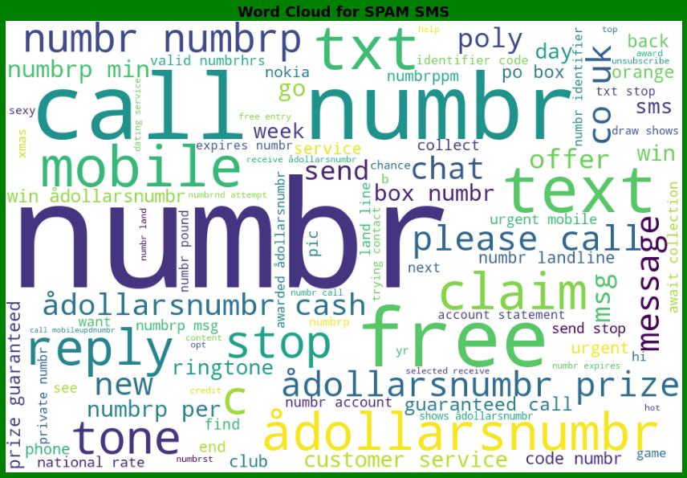
Word Cloud Word Cloud for SPAM SMS

Slide 13
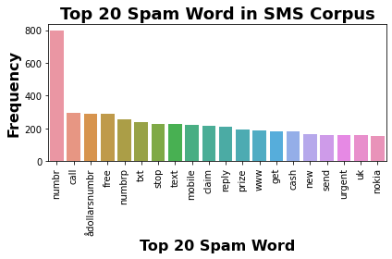
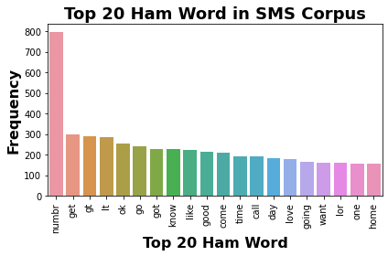
Word Cloud Top 20 Ham & SPAM Word in SMS Corpus

Slide 14
Machine Learning Model Building
Objective is to predict whether email is spam or not. It can be solve by application of classification ML algorithm.
Different Classification algorithm used to train model, in order to have maximum accuracy score.
Machine learning classification algorithms used in this project are –
Logistics Regression
MultinomialNB Classifier
Random Forest Classifier
BernoulliNB Classifier
Extra Trees Classifier

Slide 15
ML MODEL Evaluation Matrix
Algorithm | Accuracy Score | Recall | Precision | F1 Score | CV Score
Logistic Regression | 0.96 | 0.87 | 0.97 | 0.96 | 0.97
MultinomialNB Classifier | 0.98 | 0.94 | 0.98 | 0.96 | 0.99
Random Forest Classifier | 0.98 | 0.93 | 1.00 | 0.96 | 0.99
BernoulliNB Classifier | 0.99 | 0.96 | 0.99 | 0.97 | 0.98
Extra Trees Classifier | 0.98 | 0.95 | 0.99 | 0.97 | 0.97
AdaBoost Classifier | 0.97 | 0.93 | 0.91 | 0.94 | 0.93

Slide 16


